Slide 1




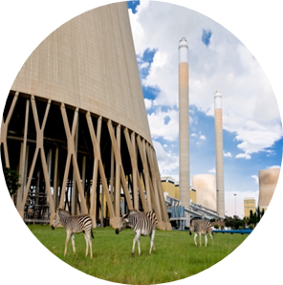

Spherical Header Tutorial
Stefan van der Walt
vdwalts@eskom.co.za
20/07/2016

Slide 2
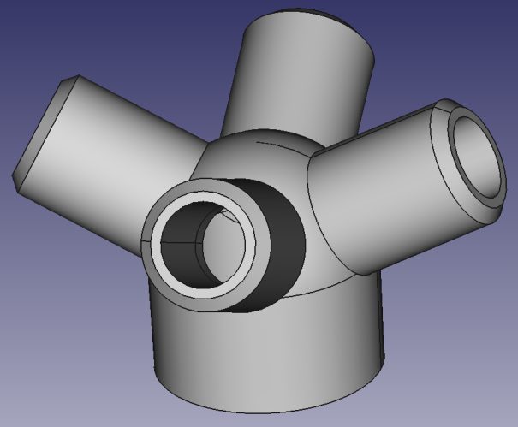
Introduction
Background:
This workshop assumes no prior experience of the FreeCAD modeling environment.
Objectives:
Create a FreeCAD project
Create a spherical header from sketches and basic 3D shapes in FreeCAD
Set up and solve a spherical header FEM model
Evaluate and understand results
Save the FreeCAD project

Slide 3
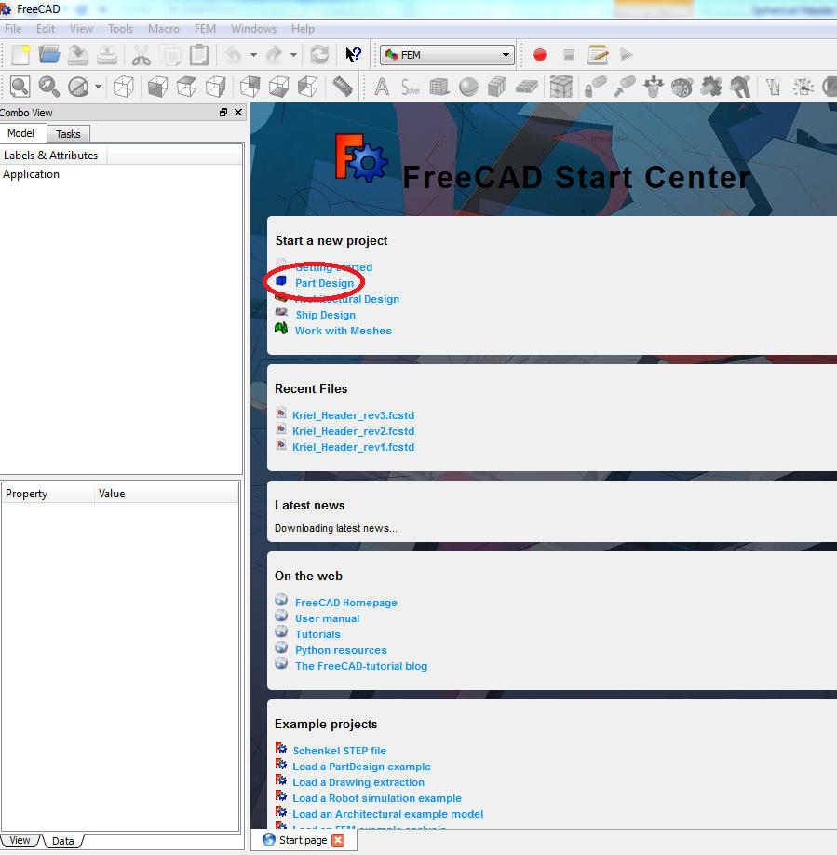
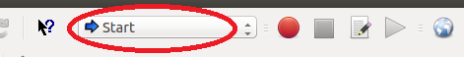
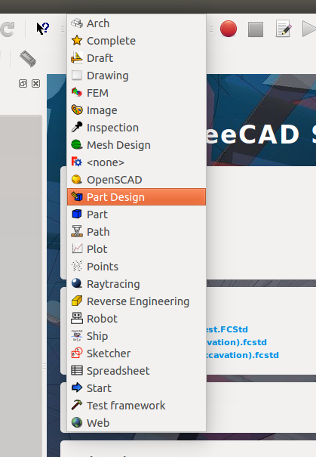
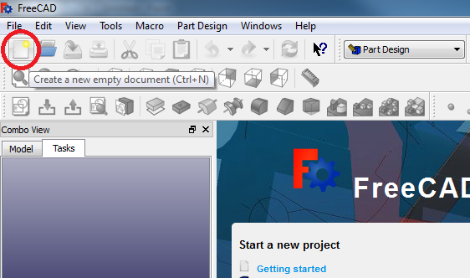
Project Startup
Create the Project:
When you open Freecad, the home screen appears.
Select 'Part Design' to start drawing the part or select ‘Part Design’ from the workbench drop-down menu.
Create a new document by clicking on the ‘Create a new empty document' icon.
It is a good idea to save the document before starting. Remember to save regularly.

Slide 4
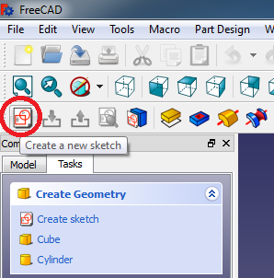
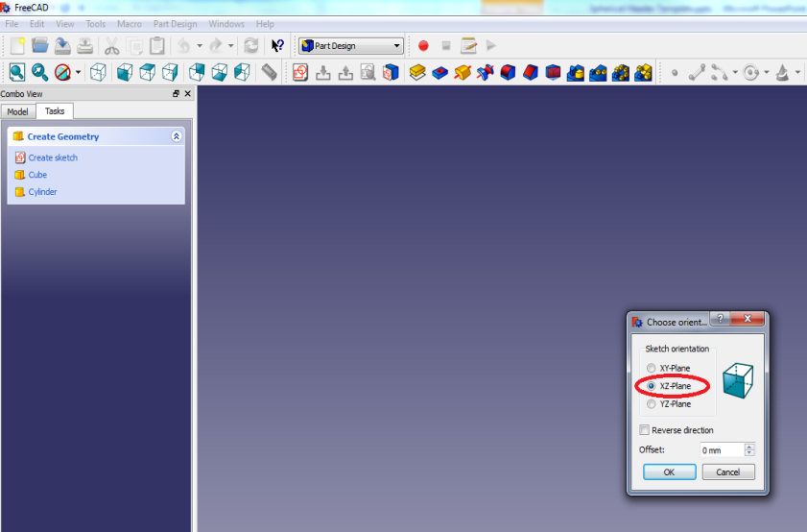
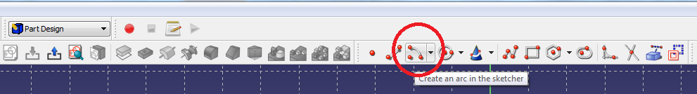
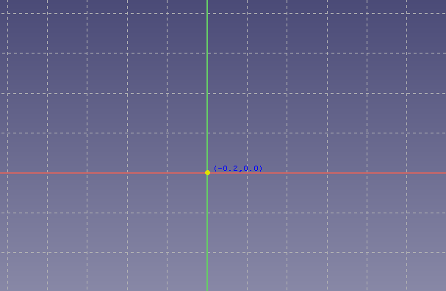
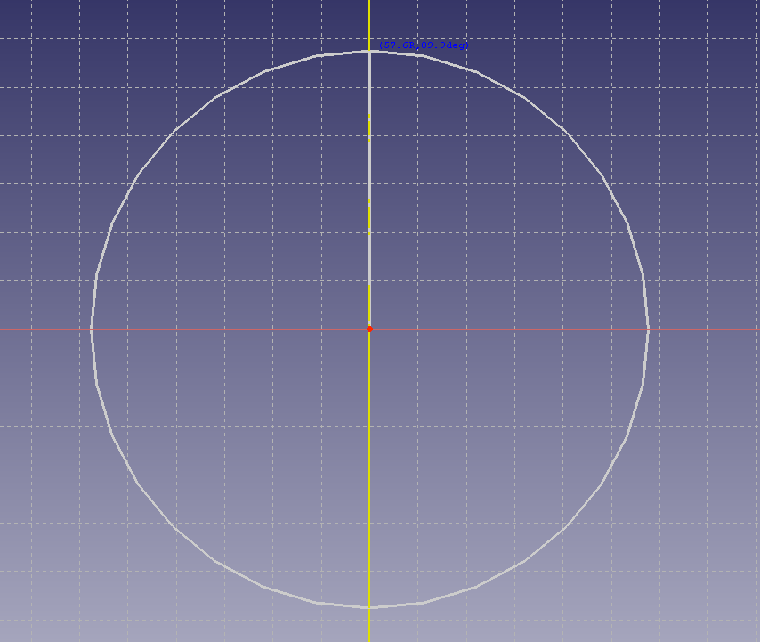
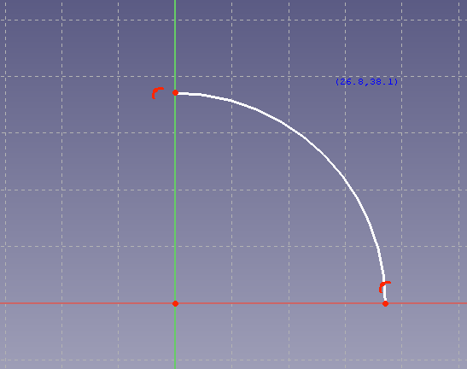
Creating the Spherical Header CAD Model
Creating the Drawing – Sketching an Arc:
Create a new sketch by clicking on the ‘Create a new sketch’ icon. A prompt appears asking on which plane you would like to create a sketch. Select the ‘XZ-plane’.
A sketch grid will appear. Select the ‘arc’ icon at the top. Remember an arc needs 3 clicks: the first click is the center point of the arc, second click is the start point and third click is the end point.
Hover near the origin with the pointer until the origin turns yellow and click and release once. The center of the arc will snap to the origin.
Now lift the pointer vertically upwards for a comfortable distance while ensuring that the z-axis turns yellow (the arc dimensions will snap to the axis). Click and release again and draw the semi-circle clockwise until the x-axis turns yellow. Click and release again.

Slide 5
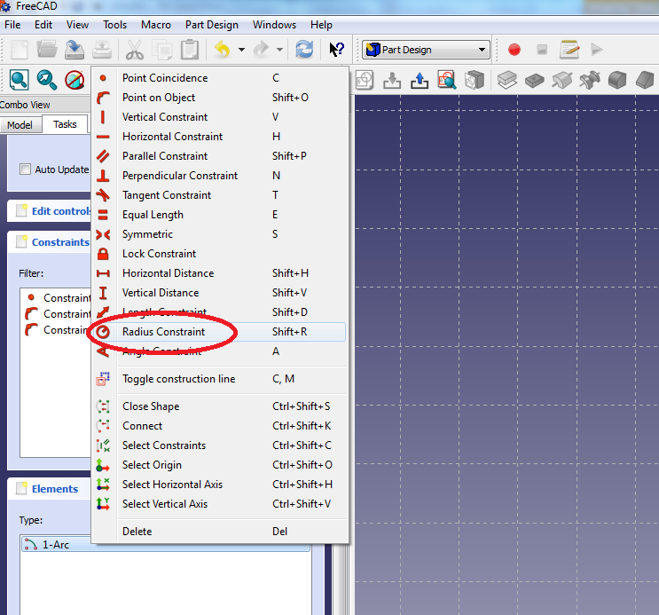
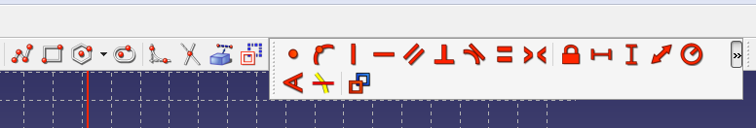
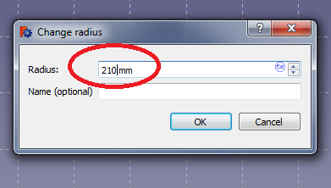
Creating the Spherical Header CAD Model
Creating the Drawing – Sketching an Arc(cont.)
After drawing the arc, right click on an open part of the screen to deactivate the drawing function or press the ‘Esc’ button on your keyboard.
Select the arc by either clicking on it in the sketch or by selecting it in the 'Elements' box in the panel on the left hand side. You will see the sketched arc turn green.
Right click on the element and select the 'Radius Constraint'. Alternatively you can select the radius constraint icon on the taskbar.
Change the radius to 210 mm.
If the constraint menu on taskbar is not visible, click expand arrow next to the constraints.

Slide 6
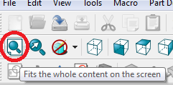
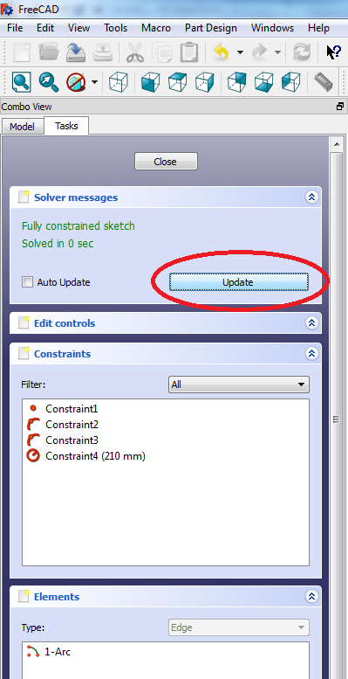
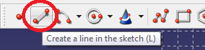
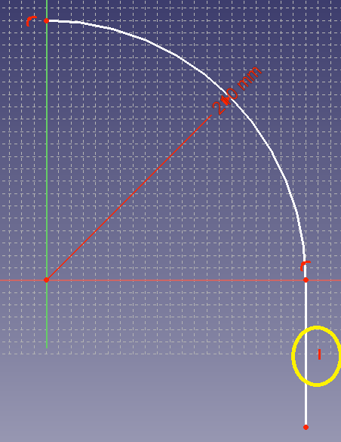
Creating the Spherical Header CAD Model
Creating the Drawing – Adding a Straight Line (cont.)
If the arc disappears from the screen due to its size, just click on the ‘Fit content to screen’ icon on the taskbar. To zoom in or out, roll the mouse wheel.
If the drawing grid doesn’t cover the sketch, just go to the pane on the left of the screen and select ‘update’ to update the sketch.
Next draw a vertical line downwards from the end of the arc. Select the ‘Create Line' icon. Hold the pointer close to the endpoint of the arc until it becomes yellow (in order to snap the beginning of the line to the end of the arc) and click and release.
Click once to start drawing the line downwards for a comfortable distance, ensuring that you see a small red vertical line next to the drawn line (this automatically creates a vertical constraint, ensuring a vertical line). Click again to draw the line.

Slide 7
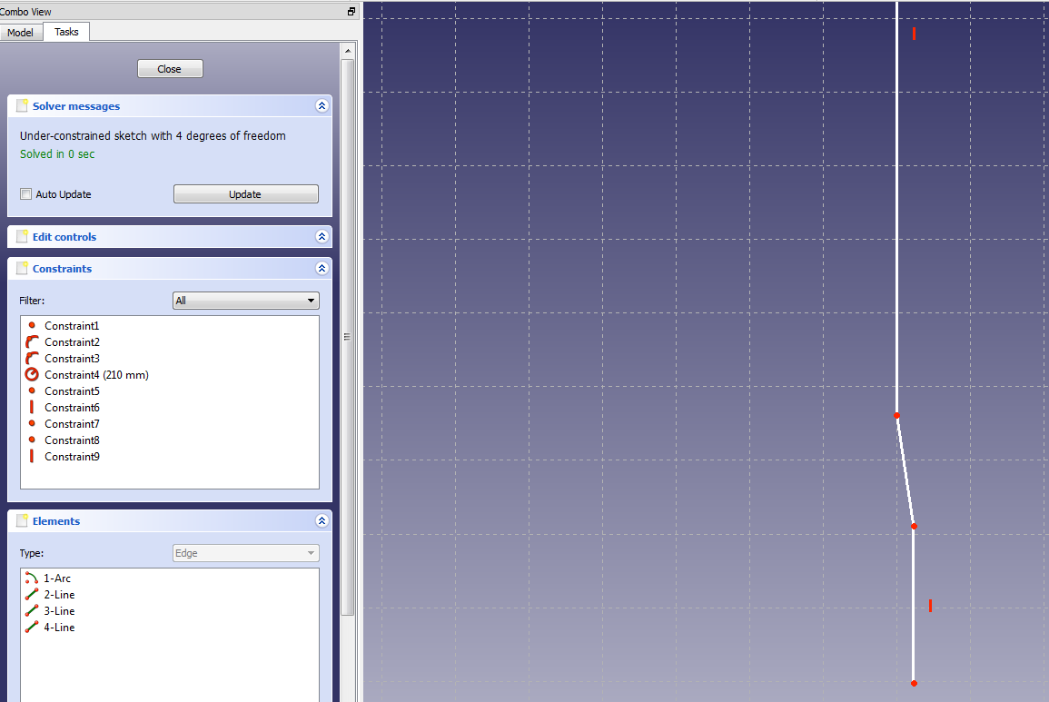
Creating the Spherical Header CAD Model
Creating the Drawing – Adding a Straight and Slanted Line
Right click on an open part of the display window to stop the line drawing function, or alternatively press the ‘Esc’ button on the keyboard.
Now start at the bottom end of the last line (wait for the point to turn yellow to ensure that the starting point of the new line coincides with the previous line’s end) and draw a line slanted to the right and downwards (numbered 1 in the figure on the right) . Don’t right click or press ‘Esc’ this time.
Click on the point at the bottom end of the slanted line (wait for it to turn yellow) and draw a vertical line downwards.
Right click on an open part of the screen or press ‘Esc’ when you are finished in order to exit the line sketch function.
1
2

Slide 8
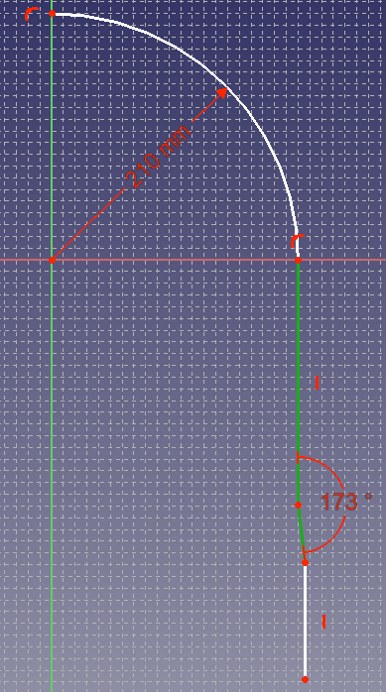
Creating the Spherical Header CAD Model
Creating the Drawing – Applying Angle Constraint
Now we will apply an angle constraint between the top line (the line that was drawn first) and the slanted line. First select both lines by clicking on them either in the sketch or in the 'Elements' box on the left side of the screen. Both lines should be green.
Now click on the angle constraint and change the angle to 173° (Relative to the vertical line to the top of it).

Slide 9
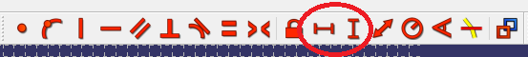
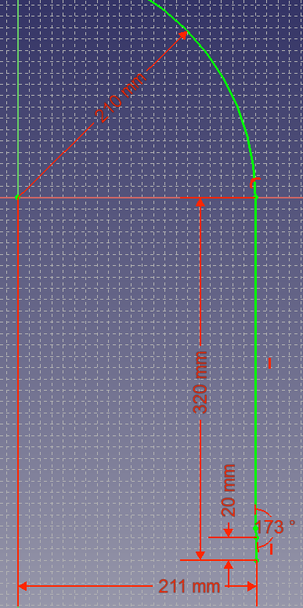
Creating the Spherical Header CAD Model
Creating the Drawing – Adding Slanted Line (cont.)
Now add the vertical distance and horizontal distance constraints as shown in the sketch.
For the horizontal constraint of 211mm between the origin and the bottom vertical line, you can select the point at the origin and the point at the bottom of the line at the bottom.
For the 320mm constraint you can select the top point of the first vertical line and again the bottom point of the bottom line.
It is a good idea to arrange all the dimensions in the sketch in a neat and legible way to avoid confusion later.

Slide 10
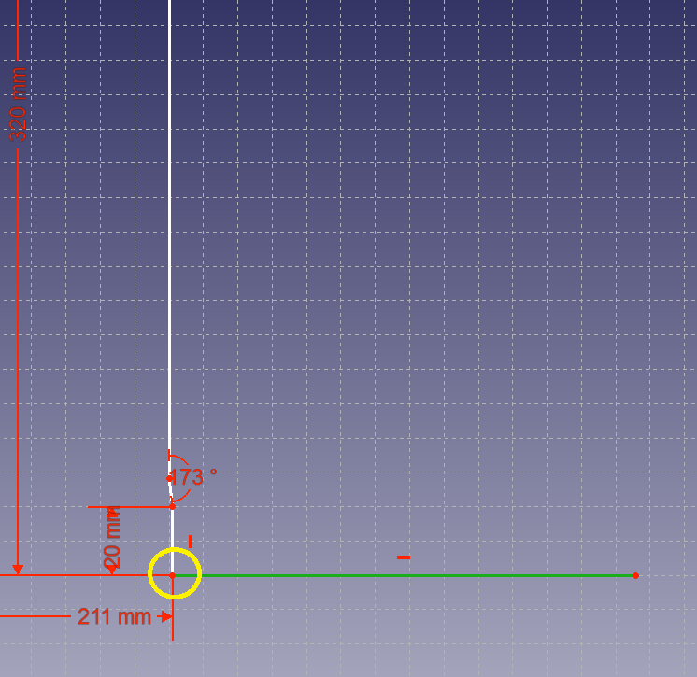
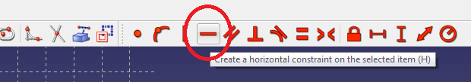
Creating the Spherical Header CAD Model
Creating the Drawing – Adding a Bottom line
Draw a horizontal line from the bottom point of the last line (the point encircled in yellow). Try to draw the line as horizontal as possible (a horizontal constraint line should appear next to the mouse pointer while drawing the line). After finishing drawing the line, right click to exit drawing mode.
Now check to see if the line has a horizontal constraint on it. If not, click on the line to select it and click on the horizontal constraint icon on the taskbar .

Slide 11
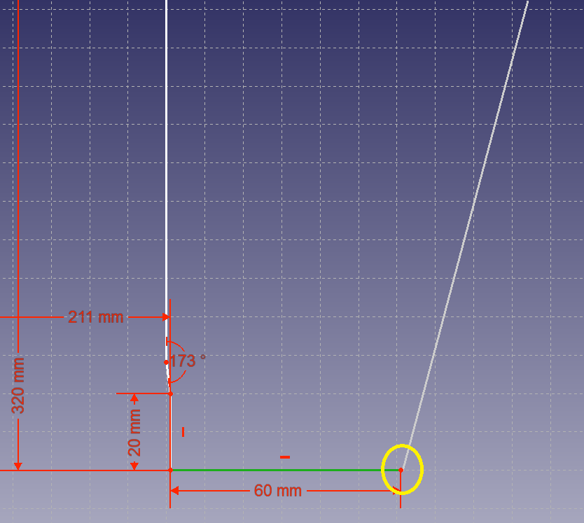
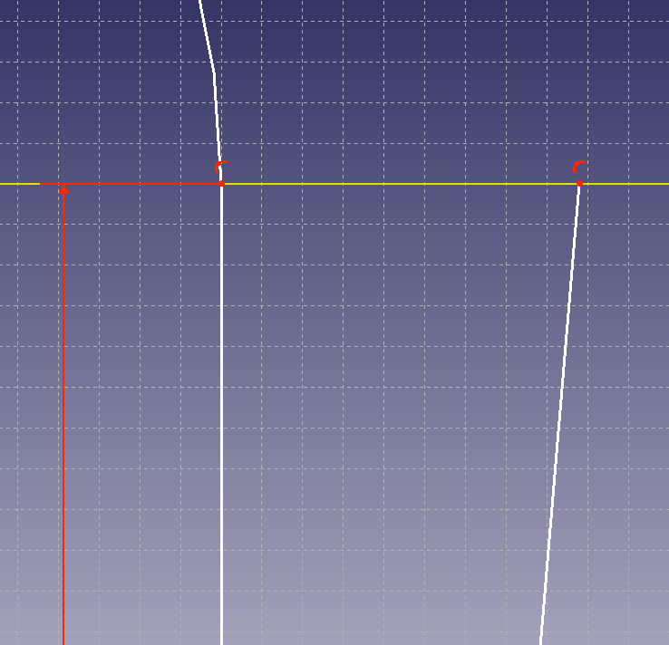
Creating the Spherical Header CAD Model
Creating the Drawing – Adding Thickness to header side
Now click on the line to select it, and click on the horizontal distance constraint icon and change the line’s length to 60mm.
Starting from the endpoint of the previous drawn line (encircled in yellow), draw another line upwards and don’t let it form a vertical constraint, rather let it slant upwards and to the right. Draw this line up to the x-axis (wait for the x-axis to turn yellow before clicking to create the line).

Slide 12
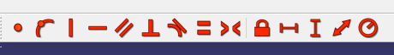
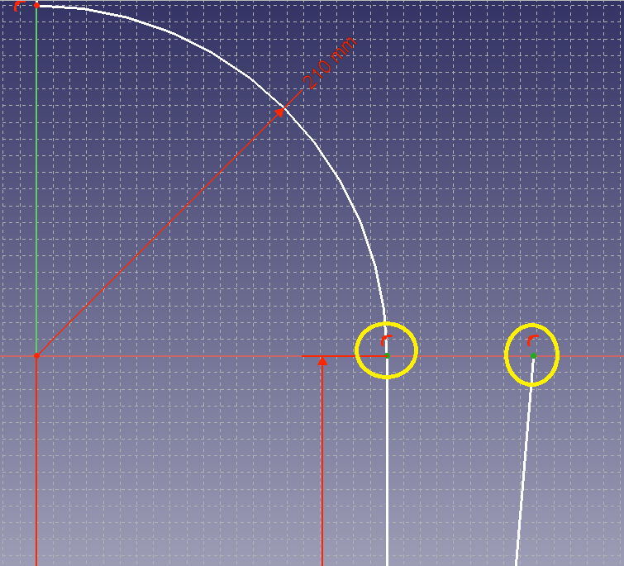
Creating the Spherical Header CAD Model
Creating the Drawing – Adding Thickness to Header Side (cont.)
Right click to exit drawing mode. Select the two endpoints shown by holding the ctrl-key and clicking on each endpoint, and apply a horizontal distance constraint of 65mm to it.

Slide 13
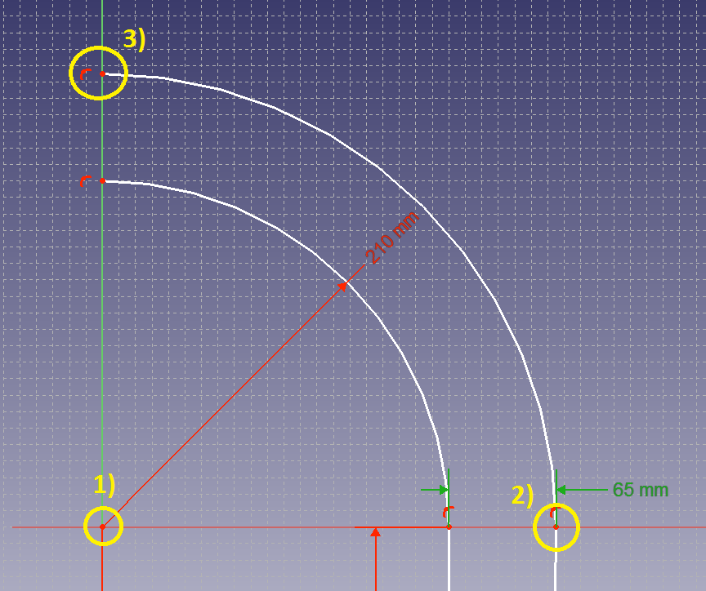
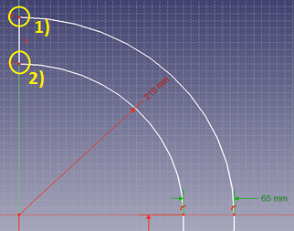
Creating the Spherical Header CAD Model
Creating the Drawing – Adding Thickness to Header Spherical Section
Draw another arc, with its radius at the plane origin.
Since the arc’s point number 2 (as shown in the sketch) already forces a constraint on the radius, there is no need to add another radius constraint.
Remember to ensure that the point at 1) turns yellow before you click, as well as the point at 2) to ensure that a coincident constraint is created. Also ensure the the z-axis line turns yellow at 3) before you click.
To close the profile draw a line from one of the yellow encircled points to the other.

Slide 14
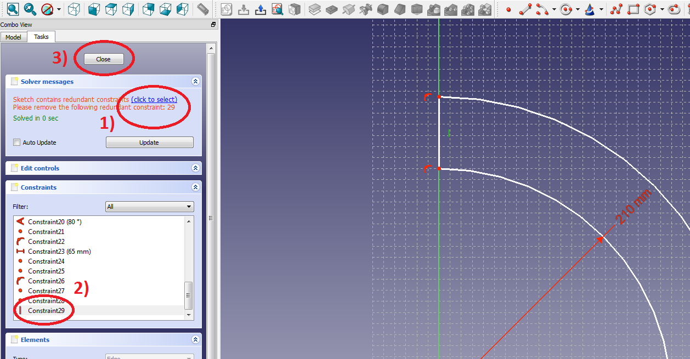
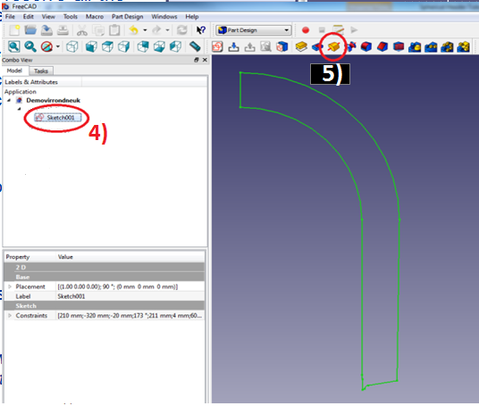
Creating the Spherical Header CAD Model
Creating the Part – Closing of Sketch and Revolve
To finalise the sketch, we must resolve all the constraint conflicts and close the sketch. Click the ‘Update’ button under ‘Solver ‘Messages’ in the Combo View to ensure all the solver messages are up to date.
To resolve the constraint conflicts, check to see which constraints Freecad complains about, click on the ‘click to select’ link and press the ‘Delete’ button on your keyboard. you can click close when the solver message says “Fully constrained sketch” in green.
Select the sketch by clicking on it in the tree view, and then click on the 'revolve' icon on the taskbar.

Slide 15
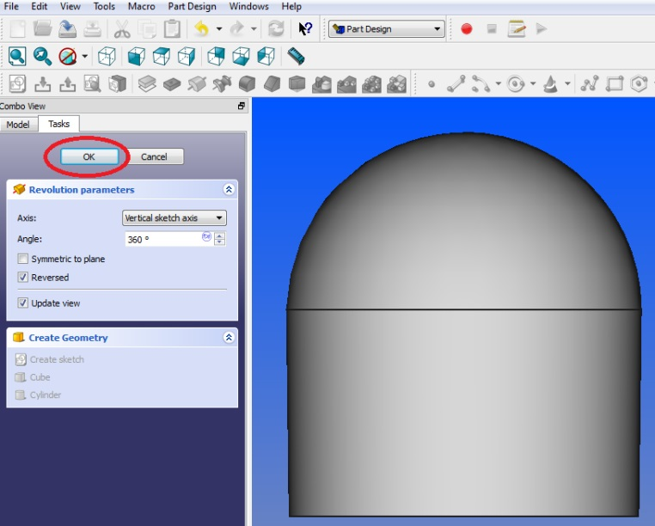
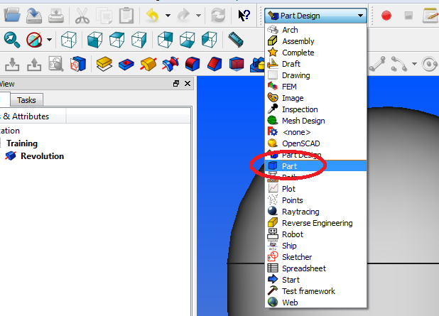
Creating the Spherical Header CAD Model
Creating the Part - Revolve
Do a full 360° revolve around the vertical sketch axis. Click 'OK'.
In the following few steps, the pipes / branches for the header are going to be created. First change over to the 'Part' workbench.

Slide 16
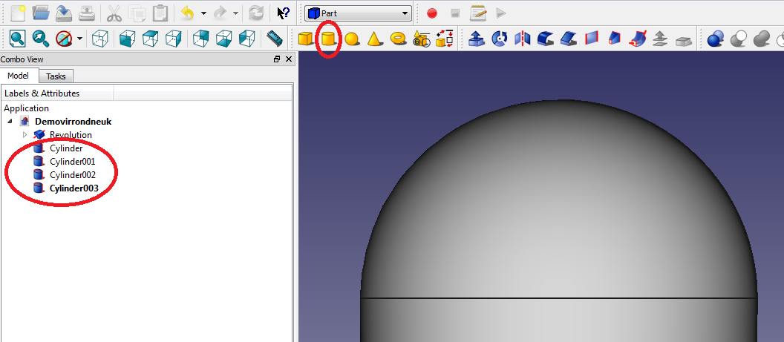
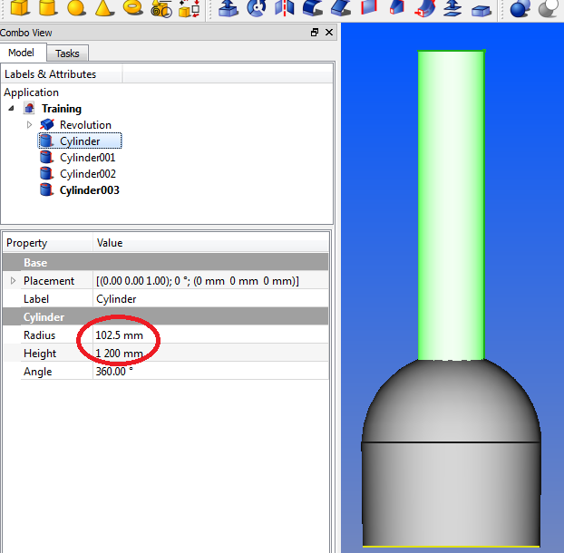
Creating the Spherical Header CAD Model
Creating the Part – Adding the Four Pipes
Click on the 'Create a cylinder' icon. A new cylinder will appear in the part tree. Repeat this until four cylinders appear in the tree.
Click on the first cylinder in the tree. Its properties will appear in the property box located under the tree view box.
In the property box under the heading ‘Cylinder’, change the radius to 102.5mm.
Change the height to 1200mm.
You should be able to see the cylinder protruding from the header section in the document window.
Change the radius and height of the other three cylinders to the same values as the first one.

Slide 17
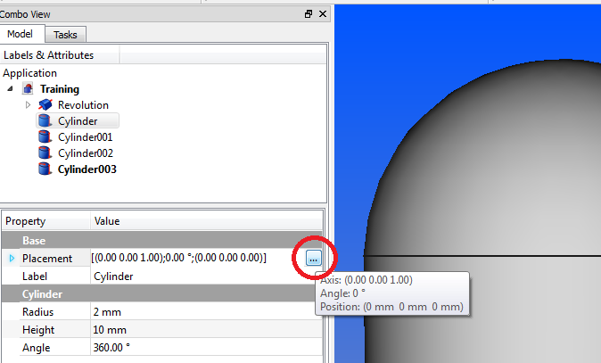
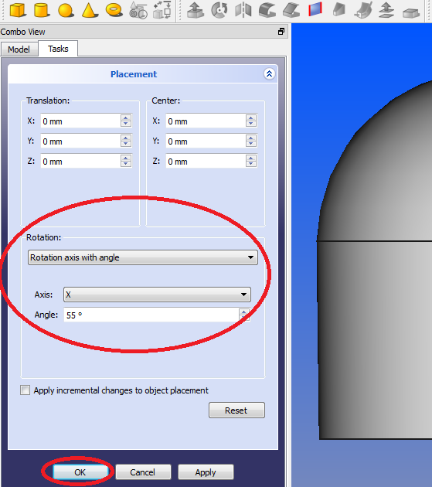
Creating the Spherical Header CAD Model
Creating the Part – Adding the Four Pipes
Select the first cylinder in the tree view again.
In the property view, click on the button next to the ‘Placement’ column. This will open the placement task box. If the button is not visible, just click in the cell containing the word ‘Placement’ and it will appear to the right of that row.
When the task box opens, ensure that the ‘Rotation’ is set to ‘Rotation axis with angle’.
Next to the heading ‘Axis’, set the axis of rotation to the x-axis.
Set the angle of rotation to 55°. Click ‘OK’ to close the task box.

Slide 18
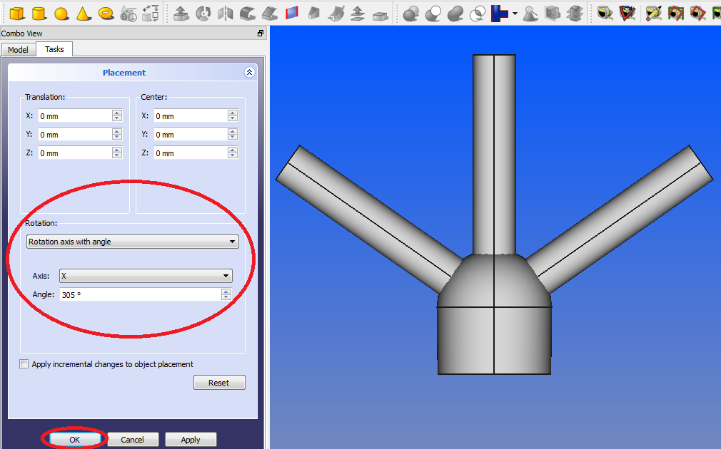
Creating the Spherical Header CAD Model
Creating the Part – Adding the Four Pipes
Select the second cylinder in the tree view and under its properties click on the button next to ‘Placement’ to open the placement task box for the second cylinder.
When the task box opens, ensure that the ‘Rotation’ is set to ‘Rotation axis with angle’.
Next to the heading ‘Axis’, set the axis of rotation to the x-axis.
Set the angle of rotation to 360° - 55° = 305°.
Click ‘OK’ when done to close the task box.

Slide 19
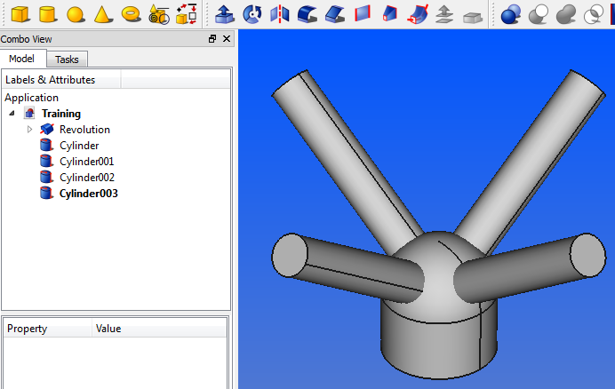
Creating the Spherical Header CAD Model
Creating the Part – Adding the Four Pipes
Similarly, open the Placement task box for the third cylinder.
Ensure the ‘Rotation’ setting is set to ‘Rotation axis with angle’.
Set the Axis to the y-axis.
Change the angle to 55° and click ‘OK’ to close the task box.
Similarly, open the Placement task box for the fourth cylinder. Ensure the ‘Rotation’ setting is set to ‘Rotation axis with angle’.
Set the Axis to the y-axis.
Change the angle to 305° and click ‘OK’ to close the task box.

Slide 20
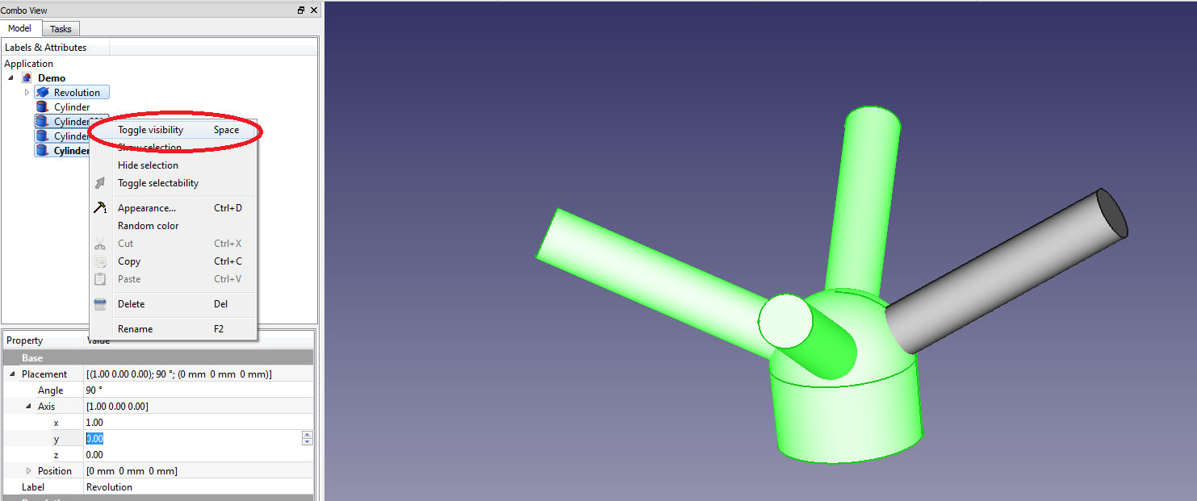
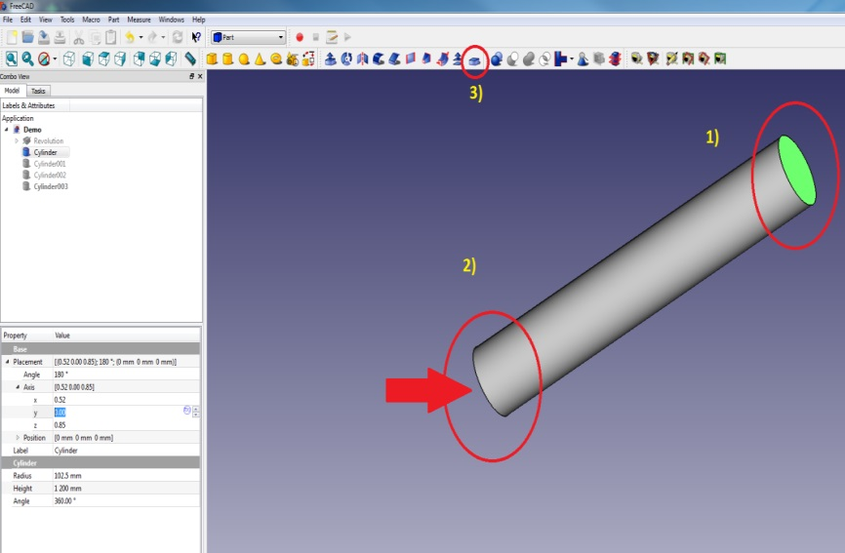
Creating the Spherical Header CAD Model
Creating the Part – Creating Thickness
Now we must hollow out the cylinders to create pipes. In the tree view, select all the components except the first cylinder using ‘Ctrl’ + click. Right click on one of the selected labels and say 'toggle visibility‘ or press the spacebar key on your keyboard. Everything should disappear except the first cylinder.
Now select the top and bottom face of the cylinder, and click on the 'Thickness‘ icon on the taskbar.

Slide 21
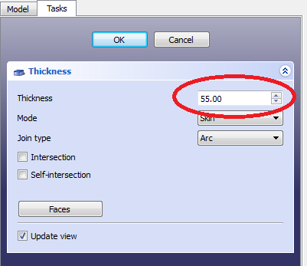
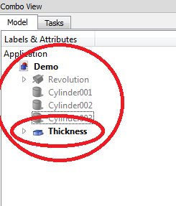
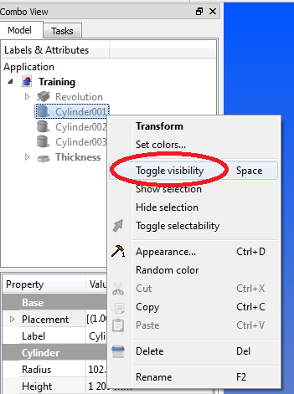
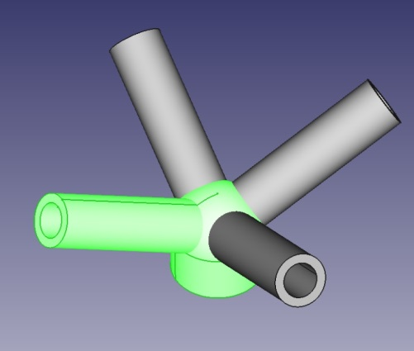
Creating the Spherical Header CAD Model
Creating the Part – Creating Thickness (cont.)
Select a thickness of 55mm and click 'OK'.
Note that the thickness feature is added in the parts tree.
Now right-click on the 'Thickness' in the tree, and select 'toggle visibility' to make it disappear. Notice one less cylinder in the tree view. The first cylinder has now moved under the thickness feature in the tree view. Right click on the next available cylinder in the tree and select 'toggle visibility' to make it appear.
Repeat the same process with all the other cylinders in applying the 'Thickness' feature.
The header should now look like the figure on the far right.

Slide 22
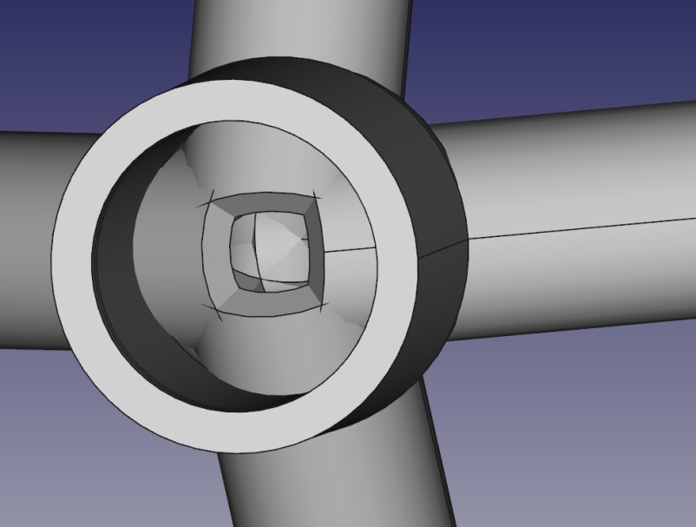
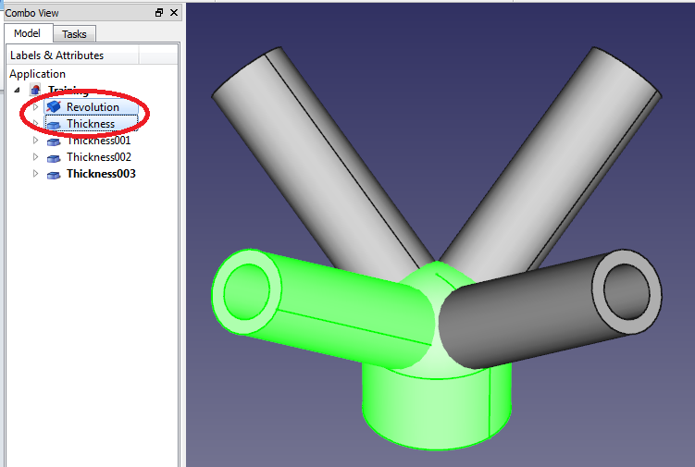
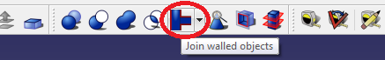
Creating the Spherical Header CAD Model
Creating the Part – Join Walled Objects
If you turn the part around, you will notice the cylinders protruding through the spherical header wall.
In order to remove this, the different bodies must be joined. The feature that is going to be used for this is the ‘Join walled objects’ feature .
Each ‘Thickness’ must be joined to the spherical header (‘Revolution’ in the tree view). From the tree view, select one 'Thickness' as well as the 'Revolution' from the list on the left and click on the 'Join walled objects' icon on the task bar. If a dropdown menu appear, select the ‘Connect’ option.

Slide 23


Creating the Spherical Header CAD Model
Creating the Part – Join Walled Objects (cont.)
You will notice that the ‘Revolution’ feature and one of the ‘Thickness’ features have disappeared from the tree view and a new feature called ‘Connect’ have appeared. The ‘Revolution’ and ‘Thickness’ feature have moved to the ‘Connect’ feature.
Select one of the remaining ‘Thickness’ features from the tree view, as well as the ‘Connect’ feature and click on the ‘Join walled object’ icon on the task bar. If a dropdown menu appear, select the ‘Connect’ option.
You will now notice that there is only two ‘Thickness’ features left in the tree view. Repeat the process on this page for the remaining two ‘Thickness’ features.

Slide 24


Creating the Spherical Header CAD Model
Creating the Part – Join Walled Objects (cont.)
When all the ‘Thickness’ features have been joined to the header, the protrusions of the cylinders will be removed and a shell will remain.
All the created features will now be grouped under the last created ‘Connect’ feature in the tree view. This feature represents the entire part.

Slide 25



Creating the Spherical Header CAD Model
Creating the Part – Adding End Caps
End caps need to be added to the pipes. Please note that this is only for specific FEM simulation purposes, and that a flat cap should never be designed and implemented as an end cap to a pipe under pressure in real life.
Change the workbench to the ‘Part Design’ workbench.
Rotate the part and select the top surface of any pipe.
Select the 'create a new sketch' icon on the taskbar.

Slide 26



Creating the Spherical Header CAD Model
Creating the Part – Adding End Caps (cont.)
The part will automatically rotate normal to the selected surface, and an axis system from the center point of the surface with a grid will automatically appear.
Click on the ‘Create a circle in the sketcher’ icon .
Hover with the mouse pointer over the center point until it becomes yellow, then click on it to start drawing the circle. The radius of the circle will change as you move the mouse outwards. When nearing the outside edge of the pipe, click again to stop drawing the circle. Right click to exit drawing mode.

Slide 27


Creating the Spherical Header CAD Model
Creating the Part – Adding End Caps (cont.)
Select the circle either by clicking on it in the display window or by selecting it under the ‘Elements’ heading in the combo view. The circle should turn green in the display window when selected.
Select the ‘Fix the radius of a circle or arc’ constraint from the taskbar, and change the radius of the circle to 157.5mm and click ‘OK’.
Exit the sketch by clicking ‘Close’ in the Tasks tab of the Combo View.

Slide 28



Creating the Spherical Header CAD Model
Creating the Part – Adding End Caps (cont.)
Now we need to extrude the circle that we just sketched to form an end cap. Select the circle by clicking on the sketch label in the tree view on the left. The circle should turn green in the sketch window. Click on the ‘Pad’ icon on the taskbar. The ‘Pad’ function will extrude the sketched circle into a cylinder.
End caps on pipes under pressure will bend outwards, which in turn will complicate the stress calculations. It’s thus imperative to increase the end caps’ thickness to at least DOUBLE the pipe wall thickness to prevent this.
Make the thickness 120 mm and click 'OK'.
Similarly, draw circles on each of the other three pipes and apply the ‘Pad’ function.

Slide 29


Creating the Spherical Header CAD Model
Creating the Part – Adding End Caps (cont.)
The spherical header part will now look like the figure on the right. Notice the end caps on each pipe, as well as the four ‘Pad’ labels in the tree view, one for each end cap.

Slide 30



Creating the Spherical Header CAD Model
Creating the Part - Cutting
Due to the part’s symmetry, only a quarter of the part need to be analysed for the FEM analysis. Subsequently we can cut away the rest of the part. Since the part is symmetric around both the x- and y-axes, we can reduce its size to a 90° section to reduce computational time.
In order to cut it, first change back to the ‘Part’ workbench. Blocks will be used to cut away the material.
Insert a cube by clicking its icon in the taskbar.
You will notice that the cube is added to the tree view as well.

Slide 31

Creating the Spherical Header CAD Model
Creating the Part - Cutting
Open its properties by clicking on the cube in the tree view. You will notice that the length, width and height can be adjusted within the properties window, as well the placement.
Click on the arrow to the left of ‘Placement’ in the property window of the cube to enlarge it. Extra options appear below ‘Placement’, including the option ‘Position’.
Click on the arrow to the left of ‘Position’ to expand it. X-, Y- and Z-coordinates appear which can be edited.
Change the X-coordinate to -1200mm, leave the y-coordinate at 0mm and change the Z-coordinate to -500mm.
Change the cube’s length to 2500mm, its width to 1200mm and its height to 1500mm.
The cube should cover half the header.

Slide 32

Creating the Spherical Header CAD Model
Creating the Part – Cutting (cont.)
This cube is going to be used to cut away half of the header.
Select the header by either clicking on the last created feature of the header (which was the pad we created for the end caps) within the tree view, or by double-clicking on the header (not the cube) in the display window.
Now also select the cube from the tree view by holding in the ‘Ctrl’ button on your keyboard while clicking on its label in the tree view. Both the header and the cube are now selected. Its important to first select the header and then the box in this order, otherwise the header is going to cut a part out of the box, and not the other way around. Both objects should be green in the display window.

Slide 33


Creating the Spherical Header CAD Model
Creating the Part – Cutting (cont.)
Once both the header and the cube is selected, click on the ‘make a cut from two shapes’ icon on the taskbar .
The header will now be halved, and a new label have appeared in the tree view called ‘cut’.

Slide 34

Creating the Spherical Header CAD Model
Creating the Part – Cutting (cont.)
Now we need to halve the remaining half of the spherical header.
Insert a cube by clicking on its icon in the taskbar .
Click on the new cube label that was added to the tree view to open its properties.
Open ‘Placement’ by clicking on the arrow to its left, and then open ‘Position’ by clicking on the arrow to its left.
Under ‘Position’, leave the X-coordinate unchanged at 0mm, change the Y-coordinate to -1200mm and change the Z-coordinate to -500mm.
Change the length, width and height to 1500mm.

Slide 35

Creating the Spherical Header CAD Model
Creating the Part – Cutting (cont.)
Now we need to use this cube to cut away half of the remaining header.
Select the header by either double-clicking on it in the display window or by clicking on the last label involving the header in the tree view (in this case it should be the ‘Cut’ label).
Now also select the cube by holding the ‘Ctrl’ button on the keyboard and clicking on the cube’s label in the tree view (it should be the label at the bottom of the tree view). Remember to select the header FIRST and only after that select the cube. Both the header and the cube should display green in the display window.

Slide 36

Creating the Spherical Header CAD Model
Creating the Part – Cutting (cont.)
Once both the header and the cube is selected, click on the ‘make a cut from two shapes’ icon on the taskbar .
The header will now be halved, and a new label have appeared in the tree view called ‘Cut001’.
The excavation still need to be added, but this will be done in Part 2 of the training.

Slide 37

END

